Slide 1




Power Learn Week 8 Database Assignment
This presentation showcases a database project designed to address the problem of inadequate antenatal care tracking systems, aligning with SDG 3: Good Health and Wellbeing.
by Wilsons Navid

Slide 2


Project Overview and SDG Alignment
This project aims to improve antenatal care tracking by developing a comprehensive database system. The system will enable healthcare providers to effectively monitor pregnant women's health, identify potential risks, and provide timely interventions. This aligns with SDG 3, which focuses on ensuring healthy lives and promoting well-being for all at all ages.
SDG 3
Good Health and Wellbeing
Target 3.1
Reduce maternal mortality ratio to less than 70 per 100,000 live births.
Target 3.2
End preventable deaths of newborns and children under 5 years of age, with all countries aiming to reduce neonatal mortality to at least as low as 12 per 1,000 live births and under-5 mortality to at least as low as 25 per 1,000 live births.

Slide 3


Problem Definition and Significance
Inadequate tracking systems for antenatal care can lead to complications during and after birth. This problem is significant because it can result in adverse health outcomes for both mothers and babies. The lack of comprehensive data can hinder early detection of potential risks, leading to delayed interventions and increased complications.
1
Lack of Data
Inadequate tracking systems often result in incomplete or inaccurate data, making it difficult to identify trends and patterns in antenatal care.
2
Delayed Interventions
Without timely and accurate data, healthcare providers may not be able to identify potential risks early enough to intervene effectively.
3
Increased Complications
Complications during pregnancy and childbirth can arise due to a lack of proper monitoring and intervention, leading to adverse health outcomes for both mothers and babies.

Slide 4

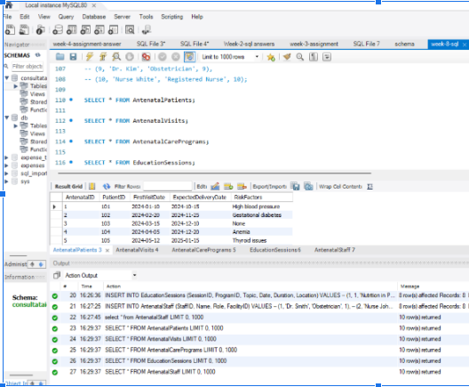
Database Design and Schema
The database schema is designed to capture essential information about antenatal care, including patient demographics, visit details, care programs, education sessions, and staff information. The schema is based on an Entity-Relationship (ER) diagram, which represents the relationships between different entities in the database.
Entity
Description
Antenatalpatients
Information about pregnant women, including their demographics and medical history.
Antenatalvisits
Details of each antenatal visit, including date, weight, blood pressure, tests conducted, and notes.
Antenatalcareprograms
Information about different antenatal care programs, including their name, description, start and end dates, and target area.
Educationsessions
Details of education sessions conducted as part of antenatal care programs, including topic, date, duration, and location.
Antenatalstaff
Information about healthcare professionals involved in providing antenatal care, including their name, role, and facility.

Slide 5
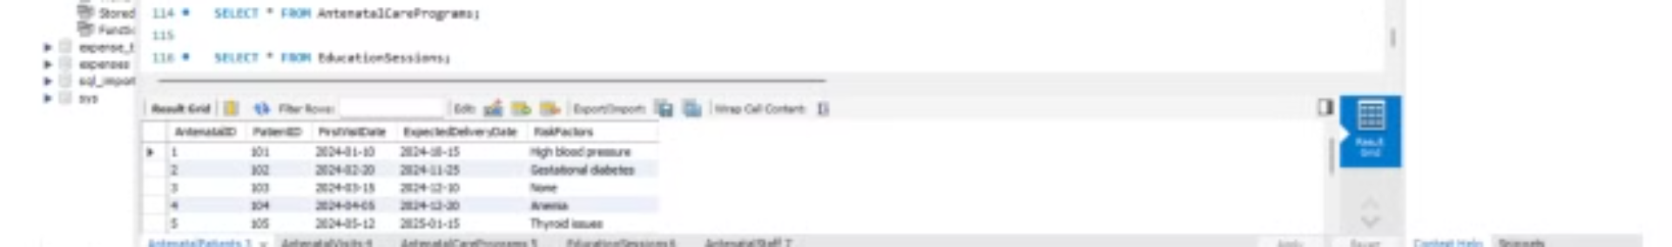
Antenatalvisits Entity
The Antenatalvisits entity captures detailed information about each antenatal visit. This entity includes columns for VisitID, AntenatalID, DATE, Weight, BloodPressure, TestsConducted, and Notes.
Column Name
Data Type
Description
VisitID
INT
Unique identifier for each visit
AntenatalID
INT
ID of the antenatal patient
DATE
Date
Date of the visit
Weight
FLOAT
Patient's weight during the visit
BloodPressure
VARCHAR
Blood pressure reading
TestsConducted
TEXT
Tests conducted during the visit
Notes
TEXT
Additional notes from the healthcare provider

Slide 6


Antenatalcareprograms Entity
The Antenatalcareprograms entity stores information about different antenatal care programs offered. This entity includes columns for ProgramID, Name, Description, StartDate, EndDate, and TargetArea.
Column Name
Data Type
Description
ProgramID
INT
Unique identifier for each program
Name
VARCHAR
Name of the antenatal care program
Description
TEXT
Description of the program
StartDate
DATE
Program start date
EndDate
DATE
Program end date
TargetArea
VARCHAR
Geographical area targeted

Slide 7


Educationsessions Entity
The Educationsessions entity captures details about education sessions conducted as part of antenatal care programs. This entity includes columns for SessionID, ProgramID, Topic, Date, Duration, and Location.
Column Name
Data Type
Description
SessionID
INT
Unique identifier for each session
ProgramID
INT
ID of the related antenatal care program
Topic
VARCHAR
Topic of the session
Date
DATE
Date of the session
Duration
TIME
Duration of the session
Location
VARCHAR
Location of the session

Slide 8

Antenatalstaff Entity
The Antenatalstaff entity stores information about healthcare professionals involved in providing antenatal care. This entity includes columns for StaffID, Name, Role, and FacilityID.
Column Name
Data Type
Description
StaffID
INT
Unique identifier for each staff member
Name
VARCHAR
Staff member's name
Role
VARCHAR
Role (e.g., obstetrician, midwife)
FacilityID
INT
ID of the facility where they provide care

Slide 9
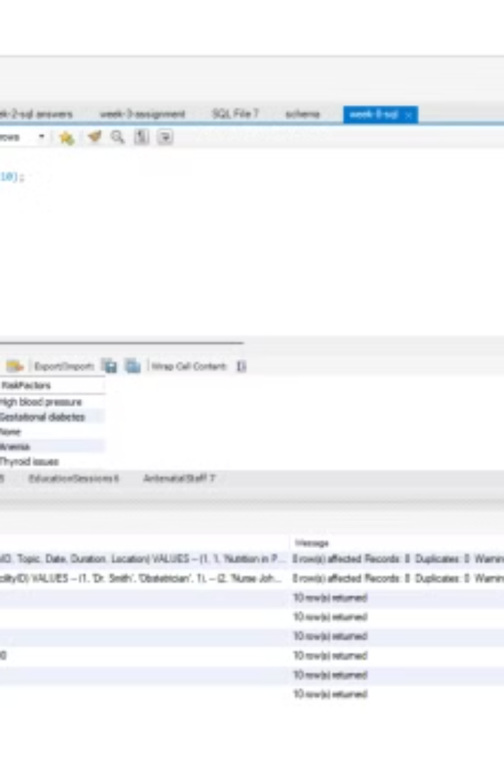
Data Analysis Insights
By analyzing the data collected in the database, healthcare providers can gain valuable insights into antenatal care practices and identify areas for improvement. This data can be used to track trends in maternal health, identify risk factors for complications, and evaluate the effectiveness of different care programs.
1
Trend Analysis
Analyzing data over time can reveal trends in antenatal care utilization, maternal health outcomes, and the effectiveness of different interventions.
2
Risk Factor Identification
Identifying risk factors for complications during pregnancy and childbirth can help healthcare providers target interventions and provide personalized care.
3
Program Evaluation
Evaluating the effectiveness of different antenatal care programs can help optimize care delivery and improve maternal health outcomes.

Slide 10
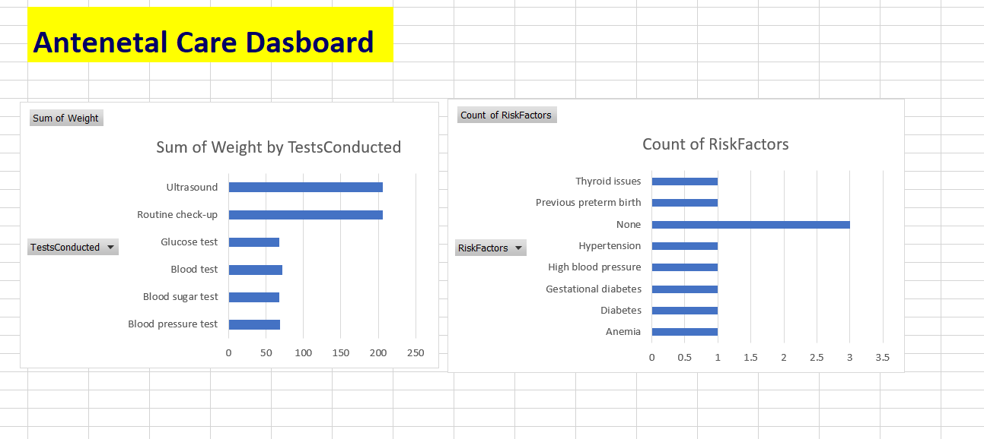
Excel Dashboard Demonstration
I integrated the database with Excel to create interactive dashboards that provide a visual representation of key data points and insights. These dashboards can be used to monitor antenatal care activities, track progress towards goals, and identify areas for improvement.
Real-Time Monitoring
Data Visualization
Interactive Features
Dashboards can be updated in real-time, providing healthcare providers with up-to-date information on antenatal care activities and patient health status.
Dashboards can include interactive features such as filters, drill-down capabilities, and data comparisons to allow users to explore data in detail.
Dashboards can use charts, graphs, and other visual elements to present data in a clear and concise manner.

